Slide 1


STFC Cross Council
and International Programmes Webinar 2024
Welcome the presentation will begin soon

Slide 2

STFC Cross Council and International Programmes Webinar
Welcome
Dr Wendy Carr
Senior Programme Manager

Slide 3


We work with the government to invest over £7 billion a year in research and innovation by partnering with academia and industry to make the impossible, possible. Through the UK’s nine leading academic and industrial funding councils, we create knowledge with impact.

Slide 4
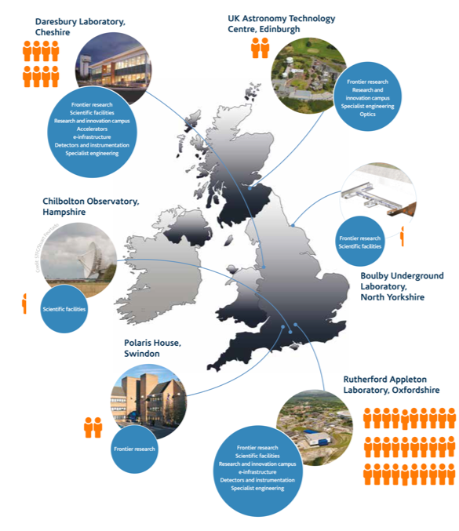
Who we are – what we do
Mission:
Discovering the secrets of the Universe
Developing advanced technologies
Solving real world challenges
£0.7bn
a year invested by STFC in research and innovation
Funding for Frontier Science
World Class Facilities
Science and Innovation Campuses
Sector Focused Clusters
Particle Physics
Nuclear Physics
Astronomy

Slide 5
Innovation from STFC
People, Training, and Knowledge Exchange
Brokerage and Engagement
21st Century Challenge Networks
Commercialisation, Translation, and Company Creation
Knowledge Transfer Partnerships
IAA
IAA
IAA
Early stage Research and Development Scheme
Late Stage Commercialisation Scheme
Early stage Research and Development Scheme
Late Stage Commercialisation Scheme
Industry Engagement Fund (IEF)
Early stage Research and Development Scheme
Late Stage Commercialisation Scheme
Commercial facility access
Industry Engagement Fund (IEF)
Business incubation centres

Slide 6
STFC Innovation Portfolio
Early-Stage Research and Development
To fund research and development with a focus on technology development in the PPAN community from technology readiness level (TRL) 1-5 in partnership with industry as appropriate.
Late-Stage Commercialisation
To fund commercialisation (TRL 5-7) developed from STFC PPAN funded research in partnership with
industry.
This scheme is jointly funded by Innovate UK
As part of the scheme we invite successful applicants to take part in the early stages of the ICURe scheme run by Innovate UK
Advantage
Funding technology readiness
Building entrepreneurial skills required to progress the idea towards the market
ICURe gives support with market readiness

Slide 7
Wendy Carr:
Late-stage commercialisation Scheme

Slide 8

What is the scheme?
The Late-stage commercialisation scheme is one of two new knowledge exchange schemes offered by STFC to support the PPAN community to develop technology and science from initial research and development towards commercialisation.
In addition, with Innovate UK we would encourage successful applicants to take part in the initial stages of ICURe
engage
discover
For the benefit of the PPAN community and the wider UK
The PPAN community is defined as particle physics, particle astrophysics, astronomy, nuclear physics, accelerator physics, solar and planetary science, quantum science and computing that underpins these areas
Any specific eligibility questions please email KEGroup@stfc.ac.uk directly for support

Slide 9
What is the scheme?
Funding available – (£600K at 80% FeC) £240K per year maximum
Grant length – 24months
Industrial Partners – It is anticipated that industrial partners are involved but not mandatory
We cannot fund industrial partners
Specific things to note –
Applicants can only be Project Lead on one application but can be Co Lead on another application
No capital equipment is permitted on these grants
Any specific eligibility questions or other questions please email KEGroup@stfc.ac.uk directly for support

Slide 10
Who can apply?
The STFC PPAN community
defined as particle physics, particle astrophysics, astronomy, nuclear physics, accelerator physics, solar and planetary science, quantum science and computing that underpins these areas
Idea from STFC funded research

Slide 11
What is the timeline?
Intention to submit opens on 20th February
Intention to submit closes on 12th March
Eligibility assessed and invitation to full stage sent via email with a link to the Funding Service
Full stage submission opens on The Funding Service on 26th March
Webinar 27th March about Full stage invitation only
Full stage submission closes on the Funding Service on 7th May
Panel in June
Grants to have a fixed start date of 1 August

Slide 12
How to apply
Intention to submit applications by an email to kegroup@stfc.ac.uk
With email subject heading Late-Stage Commercialisation Scheme intention to submit
Emails to be received by 5pm on 12th March
More details will be on the funding finder including the template which you must use to apply for the scheme

Slide 13
How to apply
To apply for the STFC Late-Stage scheme, all applicants are required to complete the below pro forma and submit it to KEGroup@stfc.ac.uk. Please title the email Late-Stage Commercialisation Scheme ItS Any applications received which have not submitted this this version of the form will not be accepted.

Slide 14
How to apply Intention to Submit

Slide 15
How to apply
Please provide a brief (less than 300 words) overview of who the project will benefit how the project has been developed from STFC science and technology
Project Technology Readiness Level (TRL) Required to be between TRL 5-7

Slide 16
Assessment
Eligibility for scheme only at the Intention to submit phase
These ItS will be assessed internally by a sift panel who will determine if the project is eligible for the scheme. They will determine if
• the applicant and lead institution meets the STFC criteria for holding a grant.
• the project TRL is suitable for the scheme
• the project has been developed from STFC science and fits within the STFC remit
• the project is of potential benefit to the PPAN community and/or the wider UK community

Slide 17
Next Steps
Intention to submit stage opens on 20th Feb – please look for the link on the funding finder
Send the completed template to me with the title
Late-Stage Commercialisation Scheme Intention to submit
I will confirm your ItS via email
If you are eligible to apply for the scheme I will contact you via email with a link
to apply to the scheme on The Funding Service
Please do not send the link you receive on to others to apply for the scheme
Webinar invitation – 27th March

Slide 18
Questions?

