Slide 1





Slide 2


Creative Industries Clusters: Wave 2 funding opportunity
Information webinar
October 2025
creative@ahrc.ukri.org

Slide 3


Agenda
1 About the Clusters
2 Scope, Criteria and Objectives
3 Application process
4 Additional information
creative@ahrc.ukri.org

Slide 4
Strategic overview
2017
Industrial Strategy
2018-23
£56m x 9 Clusters
2025
Industrial Strategy
2025-33
£100m for Clusters
Our investment:
attracted an additional £5 for every £1 of AHRC spend
grew the economy and the skills base across the sector
demonstrated the value of university-led R&D in a sector that makes up 6% of UK economic activity
creative@ahrc.ukri.org

Slide 5
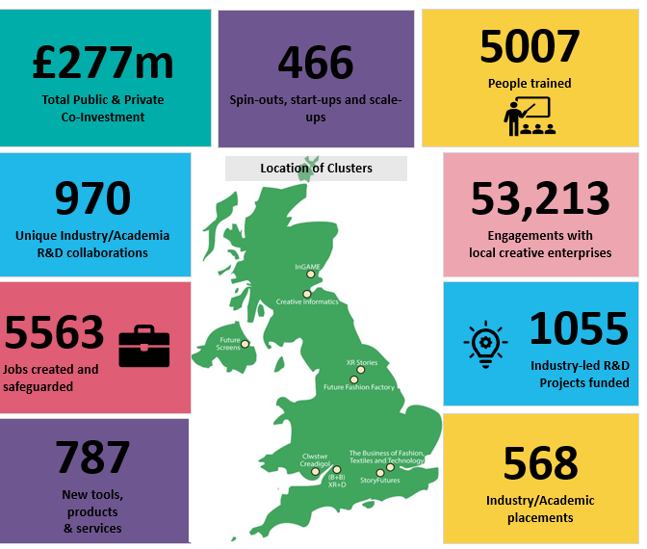
What is a Cluster?
Bring together universities, businesses, local and regional policymakers and private funders
Create R&D driven commercial opportunities, strengthen regional capabilities and deliver real world impacts via devolved funding.
Route to co-investment and leverage, the creation of jobs, skills, products and experiences
creative@ahrc.ukri.org

Slide 6
Scope and Criteria
Broaden the geographical reach of the Clusters portfolio
Expand the cluster model into sub-sectors and challenges not addressed in cohort 1
Contribute to the delivery of the UK’s Creative Industries Sector Plan
Directly address known sector challenges as part of their work
Or both!
Strategic alignment
Co-investment
creative@ahrc.ukri.org

Slide 7

Core Cluster
objectives
Create an ecosystem for new and experimental creative content, products, services and experiences
Address key EDI challenges for the creative sector, through applied research programmes
Improve creative businesses’ access to the skills, knowledge and expertise to develop new innovative products and services
Generate economic growth, new jobs, and social & cultural benefits.
Generate long-term, strategic, applied research partnerships between creative enterprises, HEI’s and other sectoral or local stakeholders
Ensure activities or approaches are working toward or will have a positive environmental or sustainable impact.
Address key place-based or sector issues through applied research programme
creative@ahrc.ukri.org

Slide 8
Important things you need to know
4 Clusters in this wave
2 more funding opportunities
2 stage assessment process
Programme delivery team
Portfolio balancing
creative@ahrc.ukri.org

Slide 9
Important things you need to know
Awards will start in Q4 of FY 26/27
Provisional timeline
Assessment panel
7th May (tbc)
Full call
closes
22nd July
We are
here!
Outline stage opens
5th January
Outcomes
announced
Panel interviews
JAN
2026
SEP
OCT
NOV
OCT
NOV
DEC
FEB
MAR
APR
MAY
JUN
JUL
AUG
Outline stage closes
3rd March
Full call opens
27th May
Assessment panel
and outcomes
Award outcomes announced
creative@ahrc.ukri.org

Slide 10
Important things you need to know
Outline stage sections (subject to change)
Vision – geography and sub-sector etc…
Challenge that needs solving
Partnerships and how established they are
Co-investment – what’s the buy-in from your partners/network
Why now? – strategic alignment
creative@ahrc.ukri.org

Slide 11
Sources of further information
UKRI Blog https://www.ukri.org/blog/creative-industries-clusters-the-next-chapter-in-a-uk-success-story/
Creative Clusters Impact Brochure Research and innovation powering the Creative Industries (ukri.org)
UKRI Blog https://www.ukri.org/blog/voices-how-our-creative-industries-make-society-better/
UKRI Blog https://www.ukri.org/blog/welcoming-the-creative-industries-sector-vision/
Clusters Programme Evaluation https://www.ukri.org/publications/evaluation-of-the-creative-industries-clusters-programme/
DCMS Creative Industries Sector Plan https://www.gov.uk/government/publications/creative-industries-sector-plan
creative@ahrc.ukri.org

Slide 12



creative@ahrc.ukri.org

Slide 13






Arts and Humanities Research Council
@AHRCpress
AHRCpress

